Slide 1

Feedbot

Slide 2
Challenge 4 Quality of education
The average student to teacher ratio is 13:1, 20:1 at many places
Teacher plays most important role in education
Students in school and college do not have basic skills because of inadequately trained teachers.

Slide 3
SOLUTION
AI Feedback portal system
Chatbot talks with people to get feedbacks in a natural conversational manner.
Analysis of responses
Visualization of the analysis in the portal to make business decisions effectively.

Slide 4
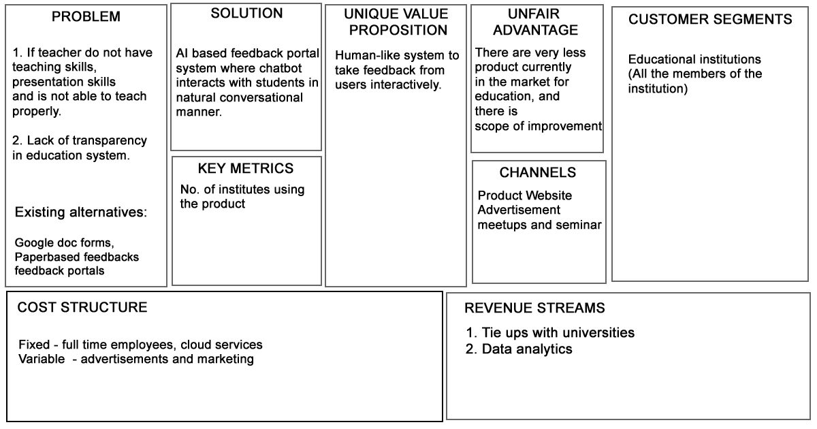
Lean Canvas

Slide 5
Positive impact
Better Experience
Conversational survey experiences much higher than traditional surveys experiences
Being heard
Chatbot asks relevant follow up questions, it gives the impression that someone is listening
More actionable insights
Can highlight key themes, context and associated sentiments about users
Make better decisions
High quality feedback for more engaged customers, ensuring you get more honest and reliable feedback.

Slide 6
TEAM Skills
Harsh Patel – Developer & Management
Bhagyashree Pandit – Web Developer
Sithara Jayachandran – Mobile App Developer
Yashesh Savani – Machine Learning Engineer
Darshan Kathiriya – Backend Developer

Slide 7
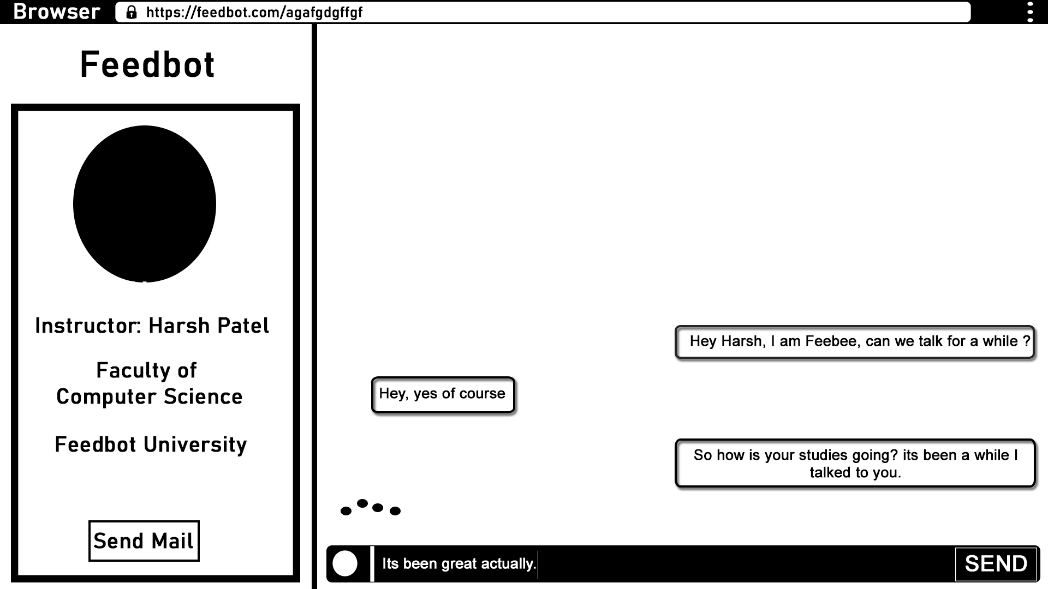

Slide 8
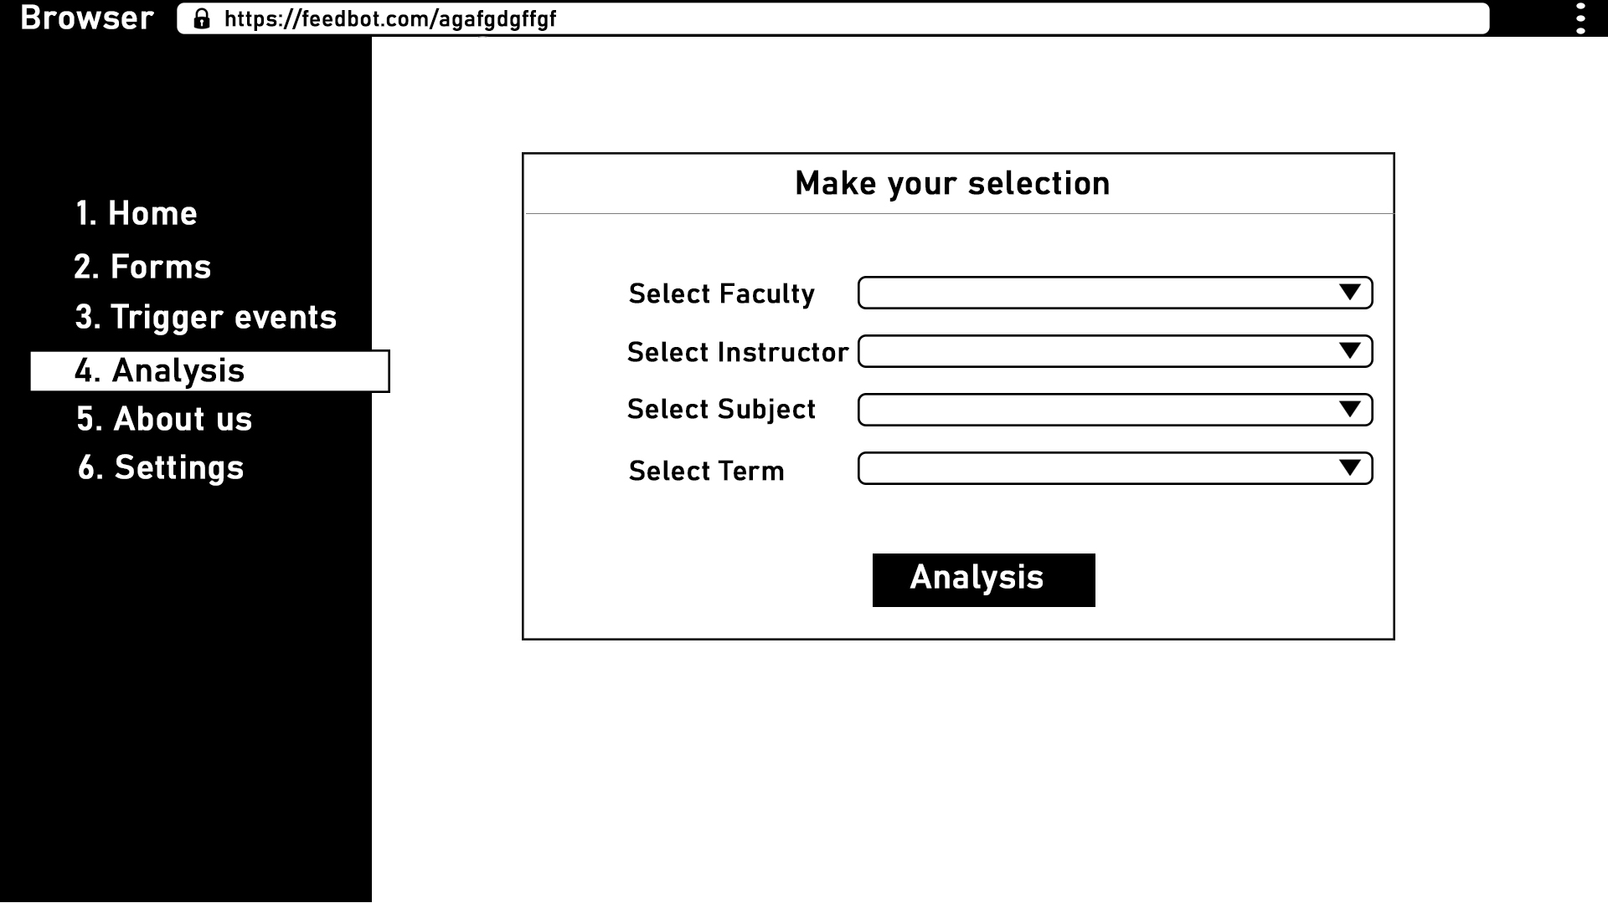

Slide 9
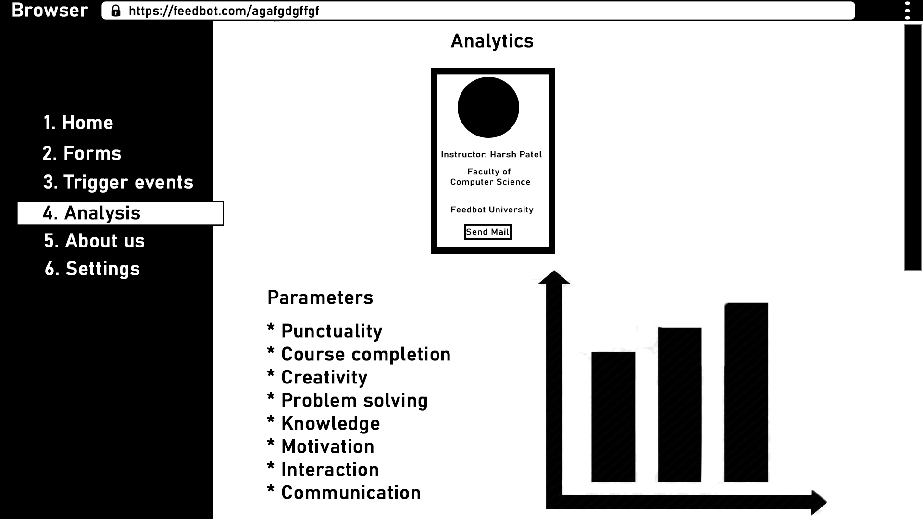

Slide 10
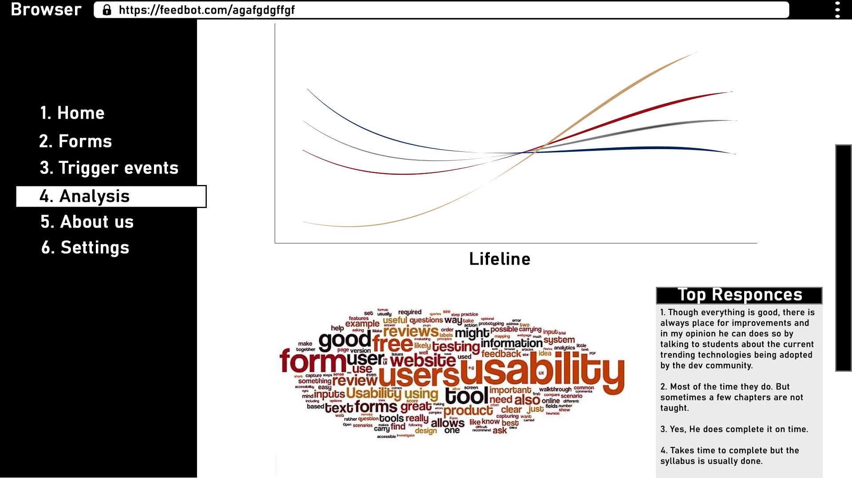

Slide 11
OUR ASK
Mentorship from an Institution
Initial Funding

Slide 12

Thank You

